Slide 1
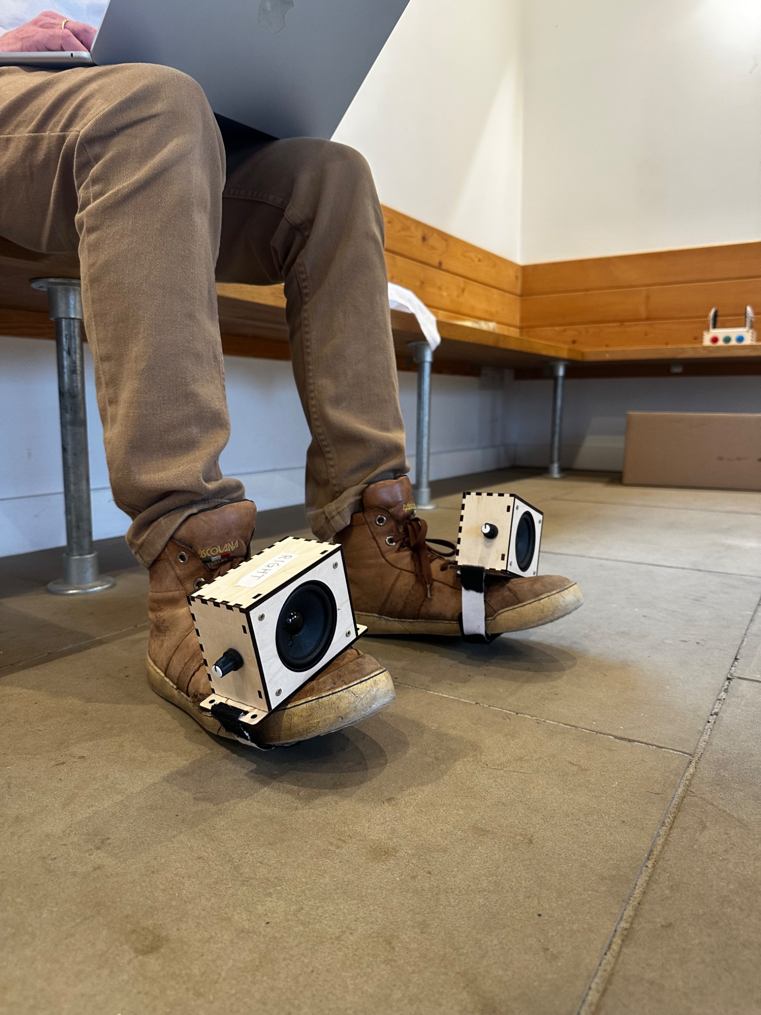
Embedded Audio
Putting sound in things

Slide 2
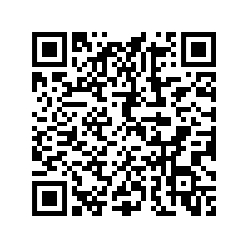

Slide 3
Schedule
Making Sound (09:30–12:30)
Standalone Audio Players
PWM Buzzers / Audio
I²S Digital Audio
Putting Sound in Things (13:30–16:30)
Start experimenting!
  Give something a voice
  Make someone jump/laugh/smile
  Put a sound somewhere unexpected

Slide 4
Standalone
Audio Players
Adafruit Sound FX Board / MP3 Players / Trigger Boards

Slide 5


Slide 6
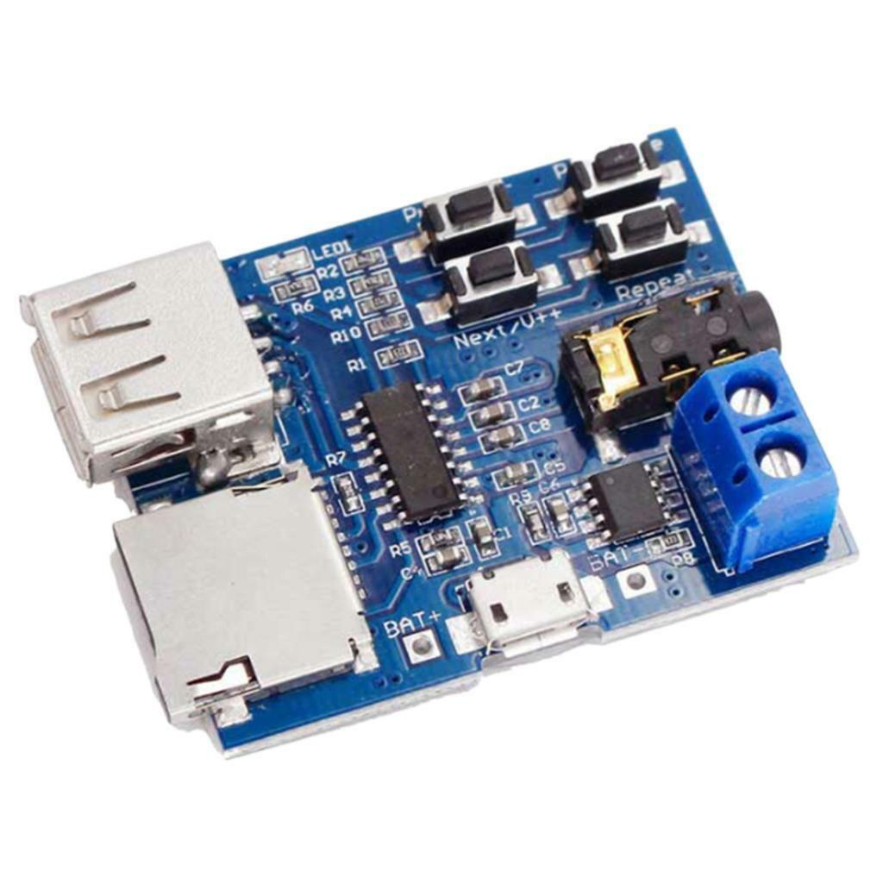
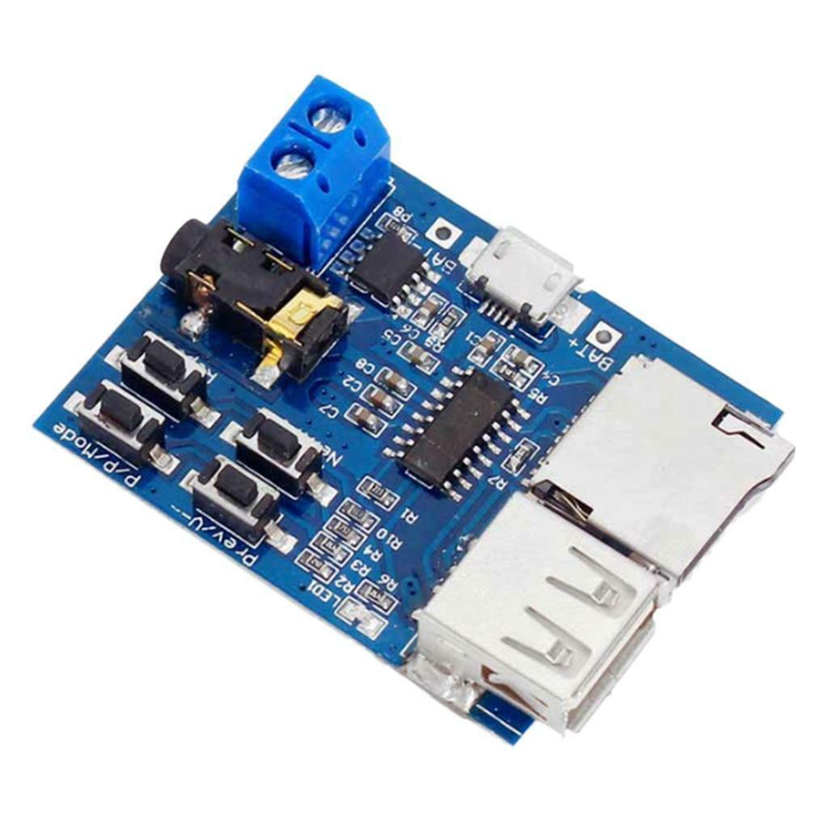
MP3 Players
Compact, low-cost audio module designed to play MP3, WAV, and WMA files directly from a micro SD card.

Slide 7


Slide 8

Adafruit
Audio FX Sound
A compact, standalone audio-trigger module that lets you add sound effects, music, or voice clips to props, costumes, toys, and DIY electronics without a microcontroller
Excellent documentation here.

Slide 9
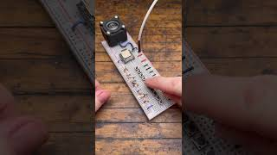
DFMini Player
Compact, low-cost audio module designed to play MP3, WAV, and WMA files directly from a micro SD card.
Excellent breakdown of its quirks here.

Slide 10
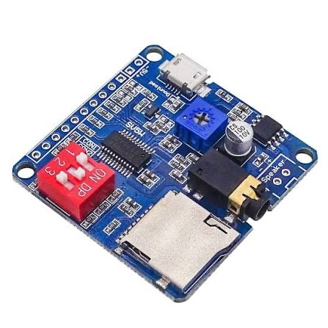
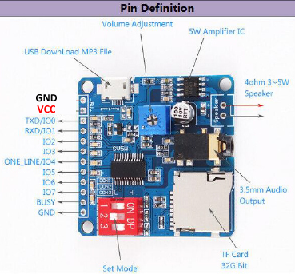
DY-SV5W Player
Compact, low-cost audio module designed to play MP3, WAV, and WMA files directly from a micro SD card.
Excellent breakdown of its quirks here.

Slide 11
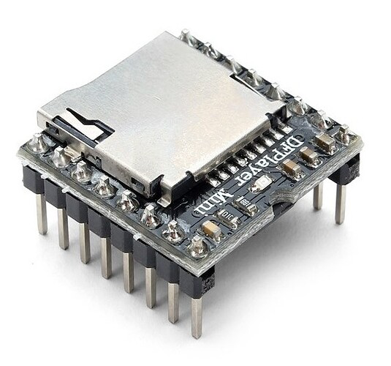
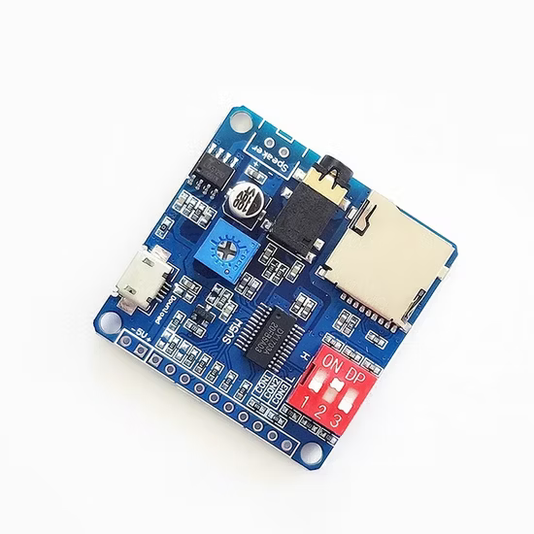
Feature | DFMini | DY-SV5W
Amplifier | 3W Mono Amp | 5W Mono Amp +
Power | 3.3-5V (more sensitive) | 5V
Storage | SD Card | SD Card (can connect USB)
Connection / Control | Resistor-ladder (or UART) | Trigger pins (or UART)

Slide 12
PWM Buzzer
Using Circuit Python on a Raspberry Pi Pico to generate tones with a Piezo Buzzer

Slide 13
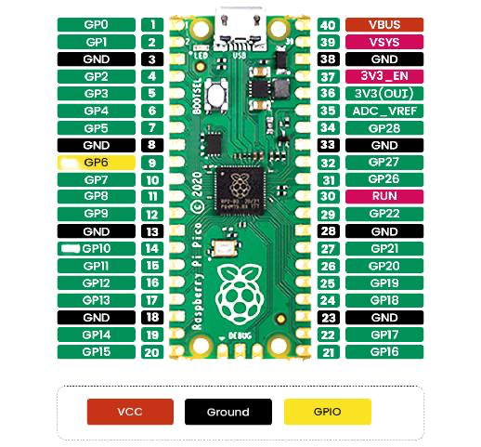
Connect your buzzer to GP1 and GND
Connect your button to GP0 and GND

Slide 14
Experiment! Pt.1
Can you make it trigger a melody whilst held or play after the button is let go?
What do we expect to hear for positive or negative user-feedback?

Slide 15
Experiment!Pt.2
Now replace the buzzer with a piezo disk.
How does the surface its attached to change the quality of sound? E.g volume and timbre.

Slide 16
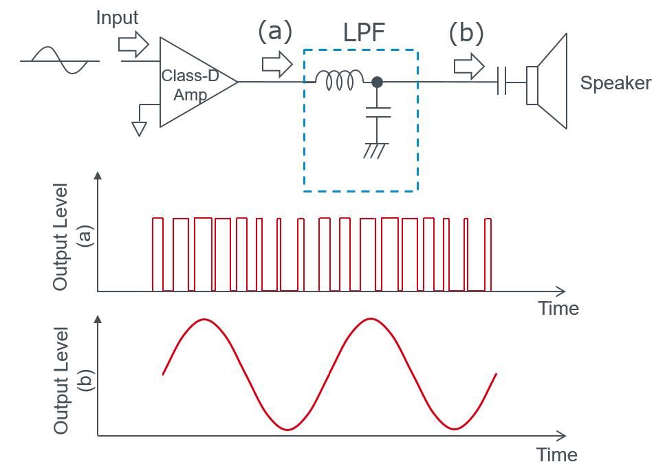
PWM Audio
Rapidly switching a digital pin on and off to ‘emulate’ an waveform

Slide 17
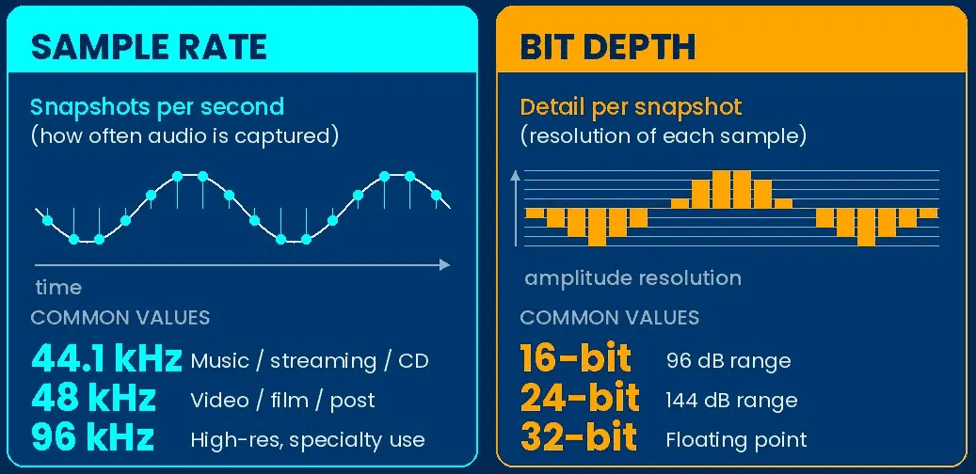
Warning!
For this to work, we need files that as formatted very specifically.

Slide 18
Warning!
Sample Rate | 22,050 hz
Bit Depth | 16-bit PCM
Channels | Mono (1 Channel)
File Format | Uncompressed WAV
We can change these in audacity.

Slide 19
Experiment! Pt.1
Now do the same as before, but using audio files. Use the example code to get started.

Slide 20
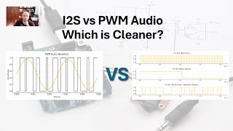

Slide 21
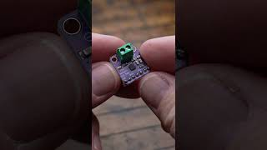
I²S Audio
Digital Audio

Slide 22
Connect BCLK to GP2, LRC to GP3 and DIN GP4
Connect GND to GND and VIN to VBUS
Connect your button to GP0 and GND
Connect speakers directly to MAX breakout board NOT the Pico.
The MAX98357A uses a BTL amplifier design. Instead of connecting one speaker terminal to ground, it actively drives both speaker terminals meaning both terminals carry changing electrical signals. The amplifier creates the audio by changing the voltage difference between these two terminals.

Slide 23
Experiment! Pt.1
Explore the example code and trigger audio files, including polyphony!

Slide 24
How to make your own audio?
Finding and editing audio.

Slide 25
How to make your own audio?
Finding and editing audio.

Slide 26
Sites
freesound.org
pixabay.com
Softwares
Audacity
Adobe Audition

Slide 27
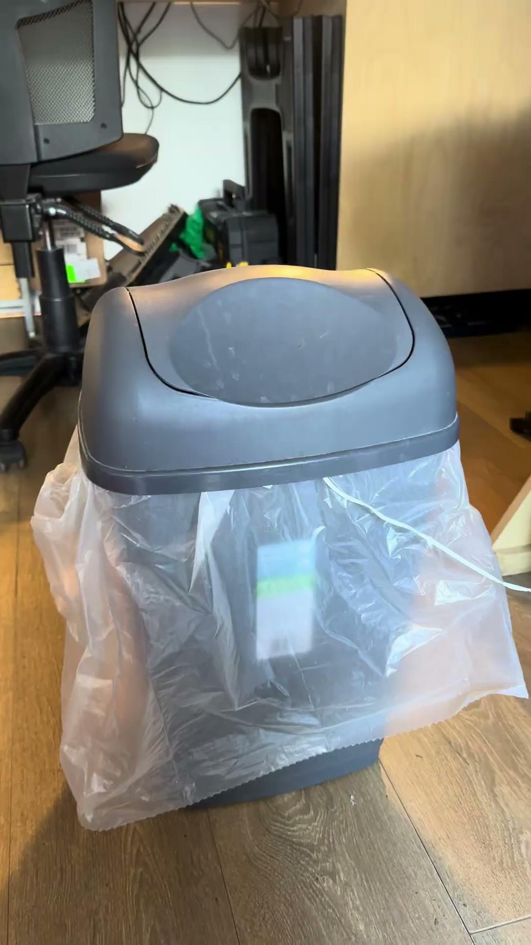
Putting sound
in a thing!

